Slide 1


Slide 2
SAP HYBRIS STAGE TEMPLATE
Please use this when presenting on stage

Slide 3
STAGE TEMPLATE COVER ALTERNATIVE
Please use this when presenting on stage

Slide 4
STAGE TEMPLATE COVER ALTERNATIVE
Please use this when presenting on stage

Slide 5
STAGE TEMPLATE COVER ALTERNATIVE
Please use this when presenting on stage

Slide 6
THIS YEAR WE GO BLACK FOR STAGE SLIDES. BLACK IS NOT A COLOR – BLACK IS SIMPLY „LIGHTS 100% OFF“.

Slide 7
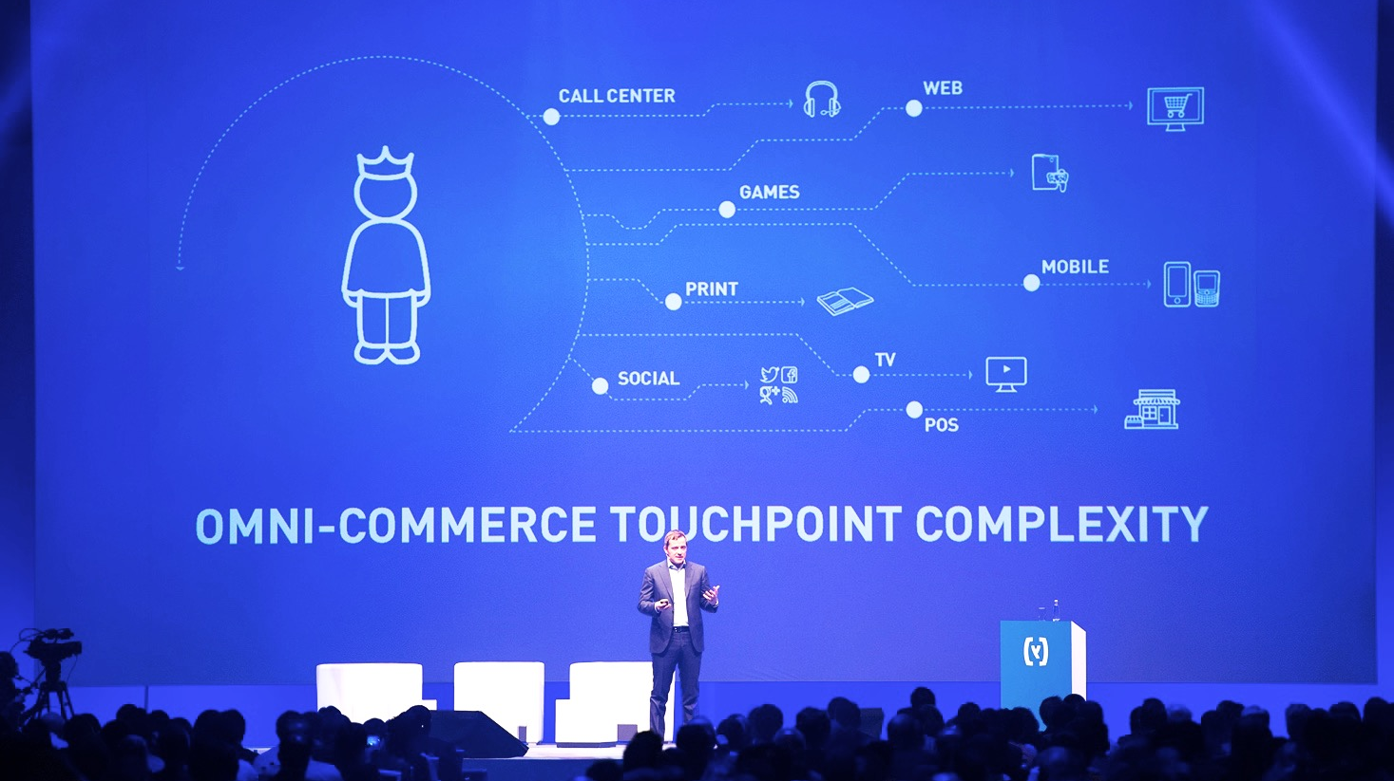
FROM HERE

Slide 8
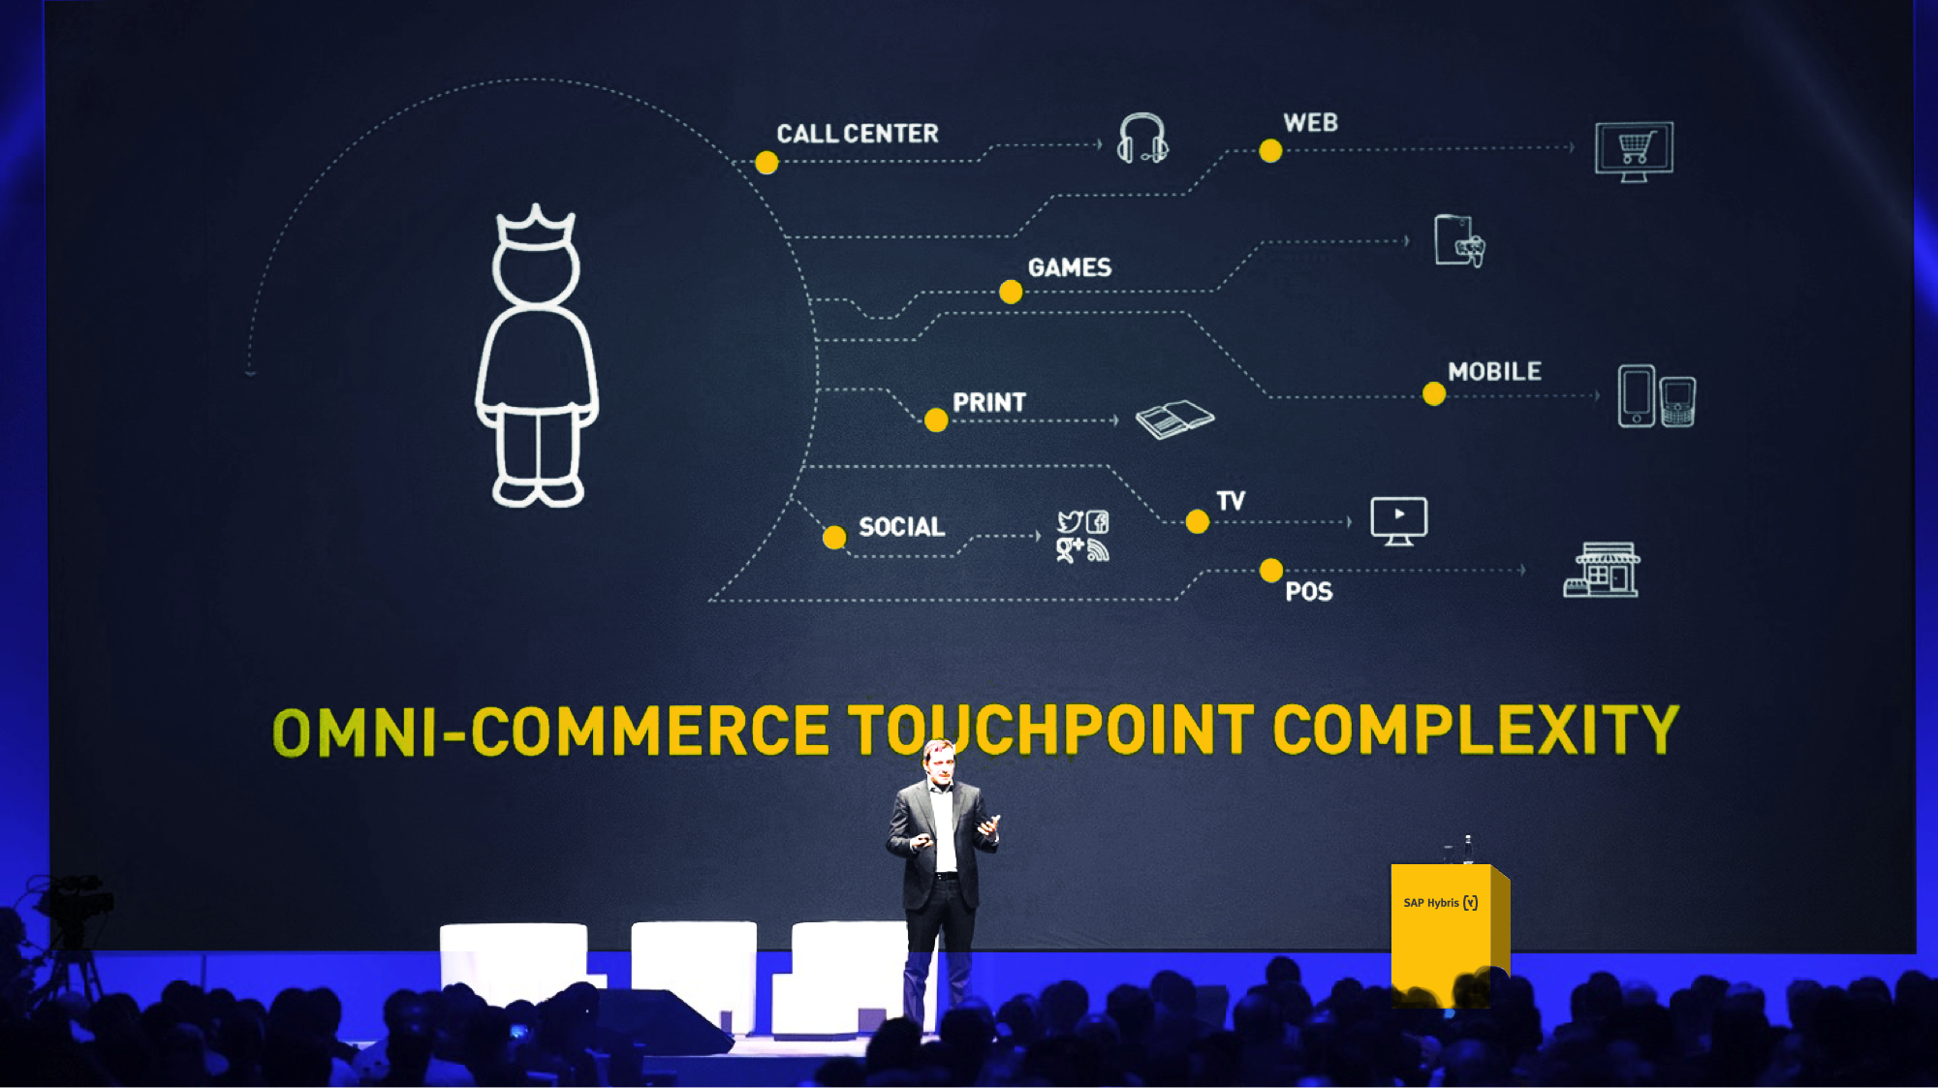
TO HERE

Slide 9
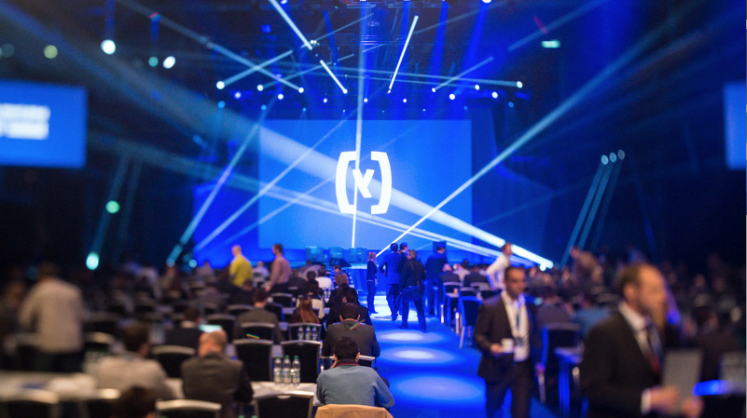
IT NEEDS TO LOOK COOL UP HERE ON STAGE.

Slide 10
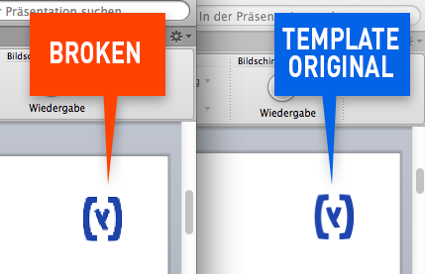
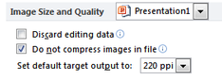
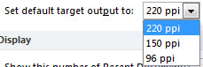
Please read this first:
You have to change settings NOW! And you possibly have to check that from time to time. Blame Microsoft…
1. Click on File > Options > Advanced
2. In the "Image Size and Quality” section check "Do not compress images in file”
3. Set default target output to “220 ppi”

Slide 11
Primary PPT colors
WHITE
SAP YELLOW
(R240, G171, B0)
BLACK
No round edges, no drop shadows. No borders.
Keep it simple. Pretty please.

Slide 12
Secondary PPT colors
LIGHT GREY
(204, 204, 204)
BLUE
(0, 100, 200)
GREY
(96, 102, 105)
DARK BLUE
(0, 50, 100)
GREEN
(79, 124, 28)
ORANGE
(227, 85, 0)

Slide 13
Page title here
Bullet Point 1
Description text here
Bullet Point 2
Description text here
Bullet Point 3
Description text here

Slide 14
Page title here
Bullet Point 1
Description text here
Bullet Point 2
Description text here
Bullet Point 3
Description text here
Bullet Point 4
Description text here

Slide 15

Handmade stories – true engagement.

Slide 16

It‘s about rhythm. Dare to write big from time to time. And see how cool white on black can be.

Slide 17
And bold
graphics

Slide 18

Use white outlines on black as default...

Slide 19
66%
47%
30%
of shoppers considered 2 or more phone models
of purchasers considered 2 or more carriers
switch carriers when purchasing
-99% vs. 2011
+134% vs. 2011
+39% vs. 2011

Slide 20
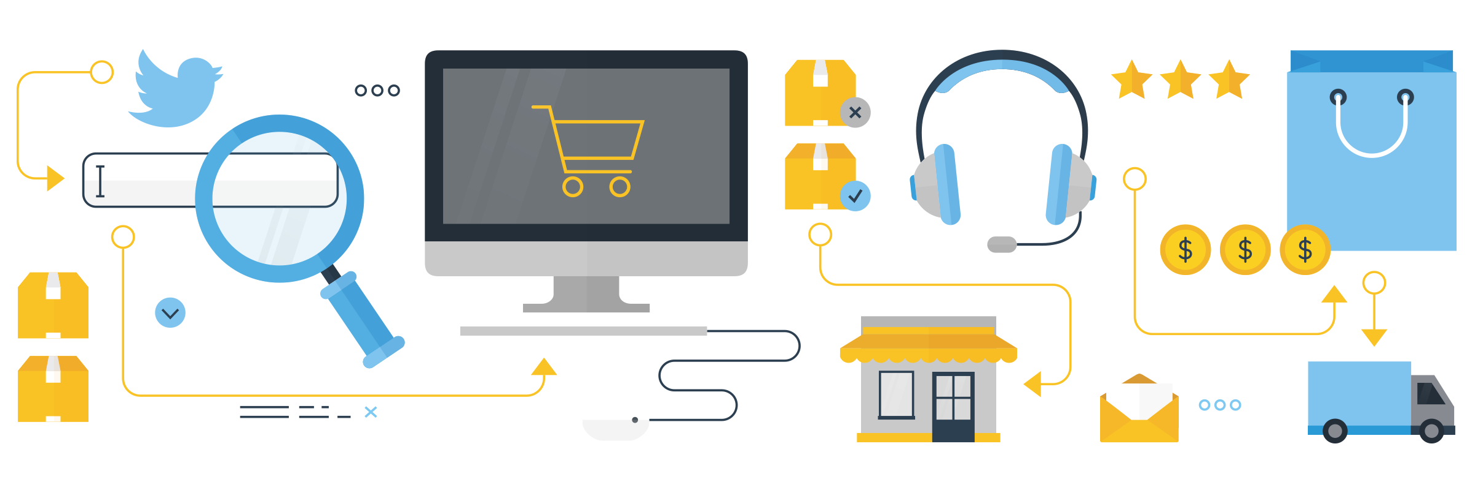

Slide 21
Three bullets? Try this:
ONE CEC
CULTURE
OUTCOME
One CEC Leadership Team
Communicate, colla-borate, transparent, inquisitive, critical thinker. Lead with intent and purpose
Areas of focus:
Team Structure & Operating Plan
Enablement Toolkits
Prioritize Development Plan

Slide 22
Sorted list example
1.
2.
3.
4.
Create Contacts
Request Knowledge Transfer
Share Your Knowledge
Forward the Mind Set to Others
5.
6.
7.
8.
Request Knowledge Transfer
Share Your Knowledge
Forward the Mind Set to Others
Create Contacts

Slide 23







SAP Hybris to power the Future of Customer Experience in China
On Prem and Cloud Solutions
Bring best Value for Chinese Customers
Execution in Complexities
Help Chinese Client to navigate the ever-changing & complex markets
Focus and Efficiency
Ensure Clarity in our solution always relevant to our customer’s Industry & Industries
Deliver Value End-to-End
Simplify end-to-end integration to power the live business of future
Local Innovations
Local Innovation & Co-innovation Labs in Shanghai, Chengdu & Beyond…
Stable Foundation
Stable Core of Customer Engagement to turbo-charge Chinese Customers’ Growth

Slide 24
Provide the world’s leading omnichannel customer engagement & commerce solution
Every touch point. Every channel.
Global. Flexible.
A next-generation enterprise software development platform.
CLOUD-READY. SCALABLE. HIGH PERFORMANCE. AGILE. DEVELOPER FOCUSED. FOR HYBRIS, SAP AND AN EVOLVING ECOSYSTEM BEYOND.
© 2016 SAP SE or an SAP affiliate company. All rights reserved.

Slide 25

Our recipe
INGREDIENTS:
Massive streams of data
PREPARATION:
Apply continuous analytics
RESULT:
Empowered front office to create real time “magic moments”

Slide 26




Another example
80%
33%
20%
5X
of consumer buying journeys start online¹
of consumers use mobile phone to research in-store
watch a video about product online before decision¹
more likely to purchase in-store after first starting the buying journey online
Retailers need a single view of customers. BUT more importantly, customers need a SINGLE view of the retailer.

Slide 27

Breaking Enterprise Software into pieces

Slide 28
Analogies that actually make sense
Customer Invitations
WHAT IS COMPLIANCE?
Marketing Events
Gifts to Customers
Customer Entertainment
Gifts from Third Parties
Secondary Employment
Meals with Third Parties

Slide 29
ENABLE GREAT EXPERIENCES. SIMPLIFY THE FRONT OFFICE. TRANSFORM AND BE AGILE.

Slide 30
Get the digital-physical fusion right
15%
30%
50%
85%
70%
50%
2000
2006
2012
2018
OFFLINE
ROPO PRODUCT
BOPIS/BORIS ORDER
TRANSCENDENCE CUSTOMER
online
online/offline
offline

Slide 31
SAP Hybris vision
Enable our customers to deliver consistent, contextual, and relevant experiences regardless of channel or device throughout the customer journey.

Slide 32
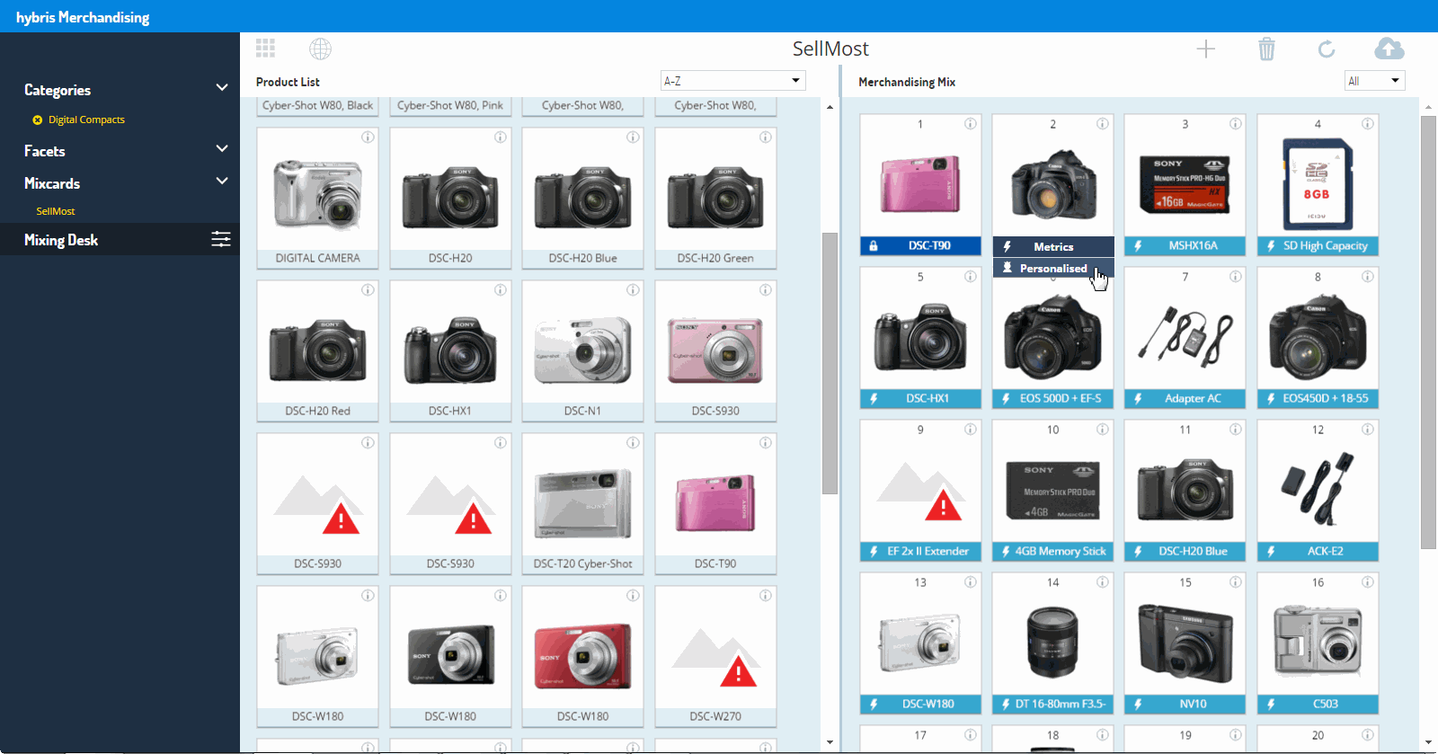
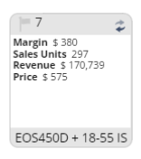

The specific performance data for each product is show on the reverse of each product tile

Slide 33

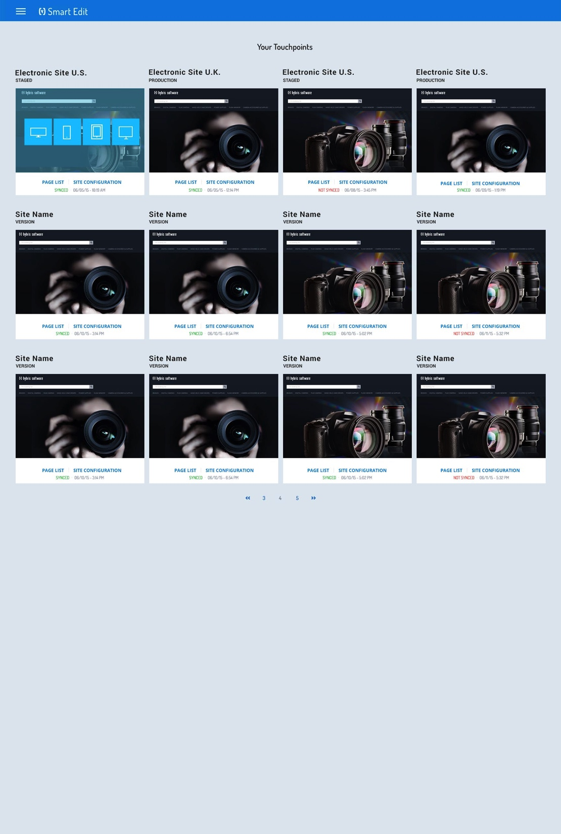
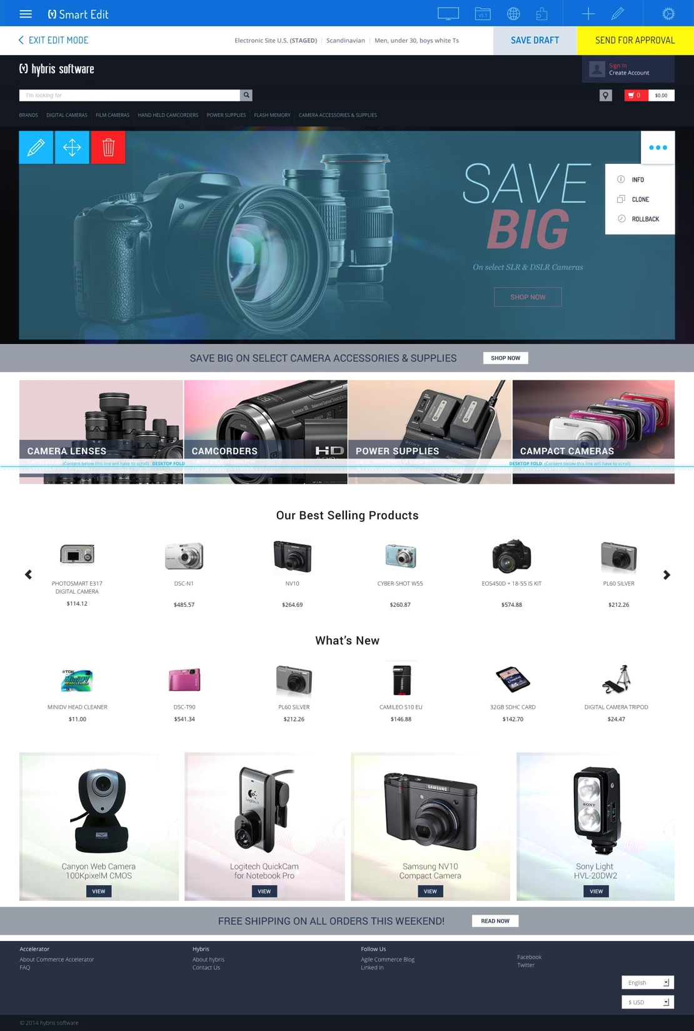

Slide 34
You want to use these objects, but it‘s one image?...

Slide 35




























Isometric elements as single objects – OK:

Slide 36


Slide 37









New fresh icons in different sizes (at constant stroke width)

Slide 38











New fresh icons in different sizes (at constant stroke width)

Slide 39






New fresh icons in different sizes (at constant stroke width)

Slide 40






New fresh icons in different sizes (at constant stroke width)

Slide 41


























Say hello to y-Man!

Slide 42





















Say hello to y-Man!

Slide 43








The family

Slide 44


















































Icons

Slide 45
















































Icons

Slide 46













































Icons

Slide 47


































Icons

Slide 48














































Icons

Slide 49

































































Icons

Slide 50

































Icons

Slide 51
Sometimes, try to help illustrate the thoughts.
CONSUMERS HAVE TAKEN THE DRIVER SEAT.
YOUR COMPANY HAS TO BECOME CUSTOMER-CENTRIC.

Slide 52




contact center
digital goods
market-place
print
In store/
branch
social
mobile
email
web
digital ads
PLATFORM
OMNI-CHANNEL LOGIC
OMNI-CHANNEL TOUCH POINTS
MASTER DATA
ORDER MANAGEMENT

Slide 53
MODULES, EXTENSIONS
PLATFORM
OMNI-CHANNEL LOGIC
OMNI-CHANNEL TOUCH POINTS
MASTER DATA
ORDER MANAGEMENT

Slide 54
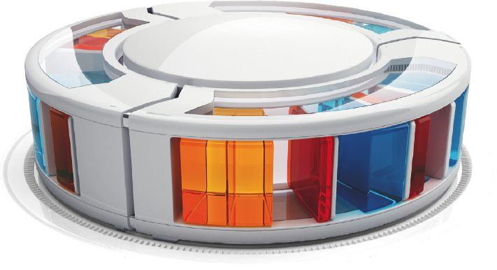

Slide 55


Slide 56


Slide 57


Slide 58


Slide 59


Slide 60




Slide 61

But why just survive?
Lead the change!

Slide 62





Customer Experience Creates Value
$.50
$1.00
$3.00
$10.00

Slide 63





Key Components For Superior Customer Experience
COMMERCE
BILLING
MARKETING
SERVICE
SALES

Slide 64



Consumers have… Look at yourself and everyone around you; always connected, aware of the environment and mostly online
Companies have … Meet Amazon, eBay, Alibaba & Uber, AirBnB; digitally native and data driven
Industries have … moving from energy supplier to turnkey solution provider; bundling energy products & add on services using digital

Slide 65


Slide 66

4 in 5 (87%)
of smartphone or tablet owners using mobile devices for shopping activities.
Source: Nielsen Connected Devices Report, Q3 2013.

Slide 67

86%
of customers are willing to pay more for a better customer experience.
Source: AMEX Global Barometer

Slide 68

62%
B2B Customers requesting Self-Service
Source: Forrester

Slide 69

5%
5% customer-sited generation could lead to a reduction in earnings for utilities of between 4% and 9%1
Source: PWC

Slide 70

It is a mind set change to fully align your business around the customer.
How you keep in touch after the sale?
How you nurture the relationship?
What you sell?
How you sell it?
How you engage?
Where you engage?
How you increase retention?
How you evolve working with suppliers & channel partners?

Slide 71



Focus on ON HOW YOUR ENGAGE CUSTOMERS The “front office”
Commerce
& Billing
Service
Sales
Marketing

Slide 72

“IN THE MOMENT”
PLAN FOR EXTREME LEVELS OF PERSONALIZATION AND CUSTOMER ENGAGEMENT

Slide 73


Slide 74

BREAK DATA OUT OF SILOS TO POWER INNOVATION

Slide 75



Understand your customer
TRIGGERS TO
Engagement
Relevance
Buy
Register
Subscribe
Return
Complete
Send
SHARE
Browse
Click
Open
Close
Ignore
Walk-by
HOVER
Implicit
Explicit
profile
Normalization
events from
Listening

Slide 76
SAP Hybris Vision
Enable our customers to deliver consistent, contextual, and relevant experiences regardless of channel or device throughout the customer journey.

Slide 77


Slide 78

DESIGN YOUR BUSINESS PROCESSES FOR TODAY’S DIGITAL CUSTOMER

Slide 79
“By 2018, one third of the top 20 in every industry will be disrupted by digitally transformed competitors.”
Frank Gens Chief Analyst, IDC

Slide 80
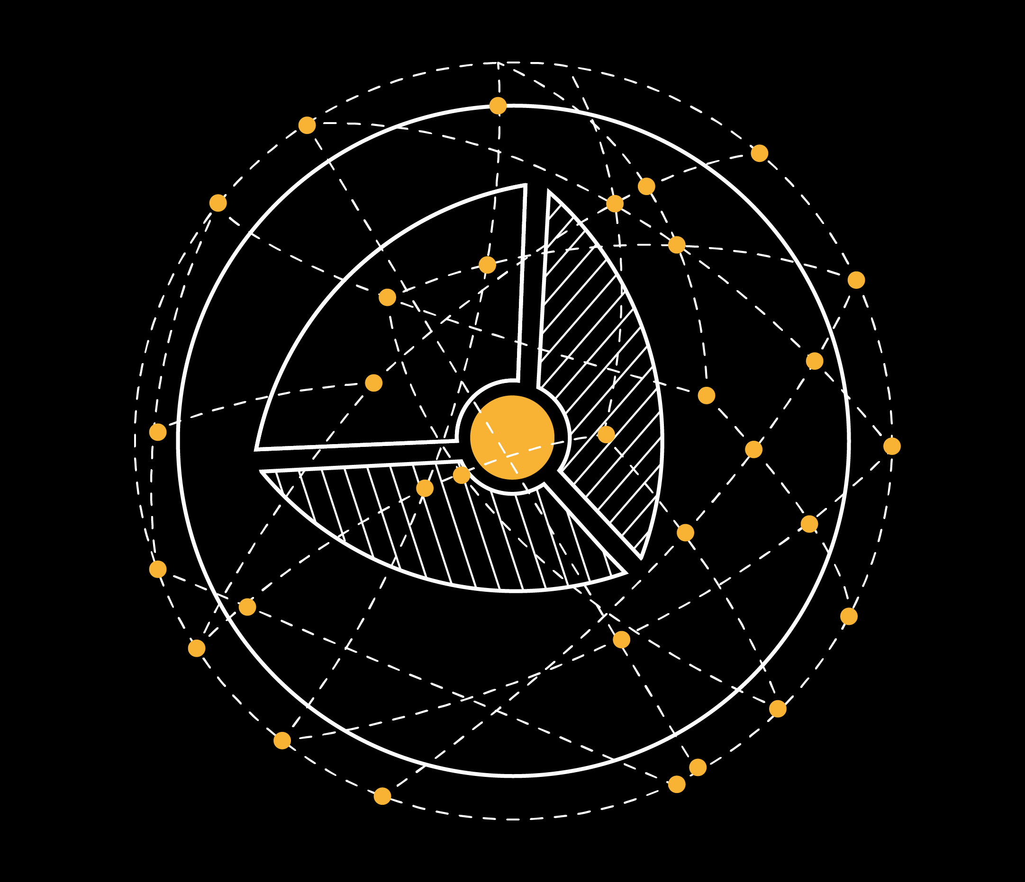
MAKE SURE TRANSFORMATION RUNS DEEP AND ENTERPRISE WIDE

Slide 81



Reimagine The Future Of Customer Experience
1900
1950
2000
INDUSTRIAL ECONOMY
CONSUMER ECONOMY
DIGITAL ECONOMY
ABUNDANCE
PRODUCTS
DESIRE
EXPERIENCE
SCARCITY

Slide 82




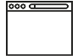












CENTER
ADDRESS
AWARENESS
Print
CONSIDERATION
Social
Contact
Center
USE
Web
Digital ADS
E-mail
Support portal
DISCOVER NEED
RECEIVE OFFER
Web-Shop
POST REVIEW
MAKE PAYMENT
TV
Social
Contact
Center
JOIN GROUPS
Word of mouth
Retail store
TRACK ORDER
SETUP PHONE
ADVOCACY
Web-Shop
RESEARCH
BUY
RECEIVE PACKAGE
Branded commu- nity
RESEARCH
Web-shop
Support portal
Contact
Center
ACTION
Search
KW/ADS
Reviews
MISSING ITEM
NETWORK ISSUE
Retail store
ACTION
Web
Contact
Center
PHONE DAMAGE
RESTART SERVICE
INTEREST
Web-shop
Retail store
BILLING ISSUE
TERMINATE SERVICE
RECEIVE OFFER
CONSIDERATION
DISCOVERY
USE
Social
Contact
Center
REFER FRIENDS
E-mail
Word of mouth
EACH CUSTOMER CHOOSES THEIR OWN ADVENTURE
Social
ADVOCACY

Slide 83




And businesses are too slow to respond
THERE ARE
1.19 BILLION SMARTPHONE USERS
400 MILLION LINKEDIN USERS
1.55 BILLION FACEBOOK USERS
AND YET
17%
76.3%
56.6%
of businesses are ready to support a mobile-first engagement with customers
of businesses’ existing CRM systems have no way to track customer social media interactions
of businesses still can’t be contacted by social media

Slide 84


Deliver personalized experiences in context
What they may do
What they are doing now
Real-time individualization from profile
Personalized experiences at each touchpoint
The customer
What they have done

Slide 85













WEB
MOBILE
IN STORE/
BRANCH
CONTACT
CENTER
DIGITAL
GOODS
MARKET-PLACE
IOT
SOCIAL
SMS/
NOTIFICATION
SEARCH ADS / SEO
DIGITAL ADS
EMAIL
PRINT
EXPERIENCE MANAGEMENT
COMMERCE
BILLING
MARKETING
SERVICE
SALES
DATA MANAGEMENT
PRODUCT | CUSTOMER
PLATFORM, INFRASTRUCTURE, INTEGRATION
SIMPLIFIED FRONT OFFICE WITH SAP HYBRIS
SIMPLIFIED FRONT OFFICE WITH SAP HYBRIS

Slide 86














SAP Hybris Commerce Architecture
Front-end Interface
.net, flash, PHP, etc.
REST Web service API
Functionality
OmniCommerce Connect™
Web
Mobile
Pos
Call Center
Social Media
Print
TV
Commerce
Master Data Management
Order Management
Backoffice UI (Cockpits)
System Administration
Customer Experience
Product Content
Channels
Reporting Analytics
Integration
Orders
Platform
Persistence
Caching
Security
Clustering
I18n
Import Export
Search
Application Server
Database
HANA

Slide 87

THE ERA OF ME.

Slide 88















Digital takeover – every minute of every day
SOURCE: DOMO, INC.
72 hrs
48,000
26,380
of YouTube uploads
Apple App downloads
Reviews on Yelp
204,000,000
216,000
23,300 hrs
Emails Sent
Instagram photos
Of connected Skype users
4,000,000
347,222
3,472
Google Searches
WhatsApp Photos
Pins on Pinterest
2,460,000
$83,000
8,3333
Facebook posts
In online sales on Amazon
Shared Vine Videos
277,000
61,141 hrs
416,667
Tweets
Of Music on Pandora
Tinder Swipes

Slide 89








AWARENESS
INTEREST
DESIRE
ACTION
SHARE
RESEARCH
VS
COMPARE
SHOP
TRIGGER EVENT
PURCHASE

Slide 90



Slide 91


CUSTOMERS CONTROL THEIR JOURNEY

Slide 92

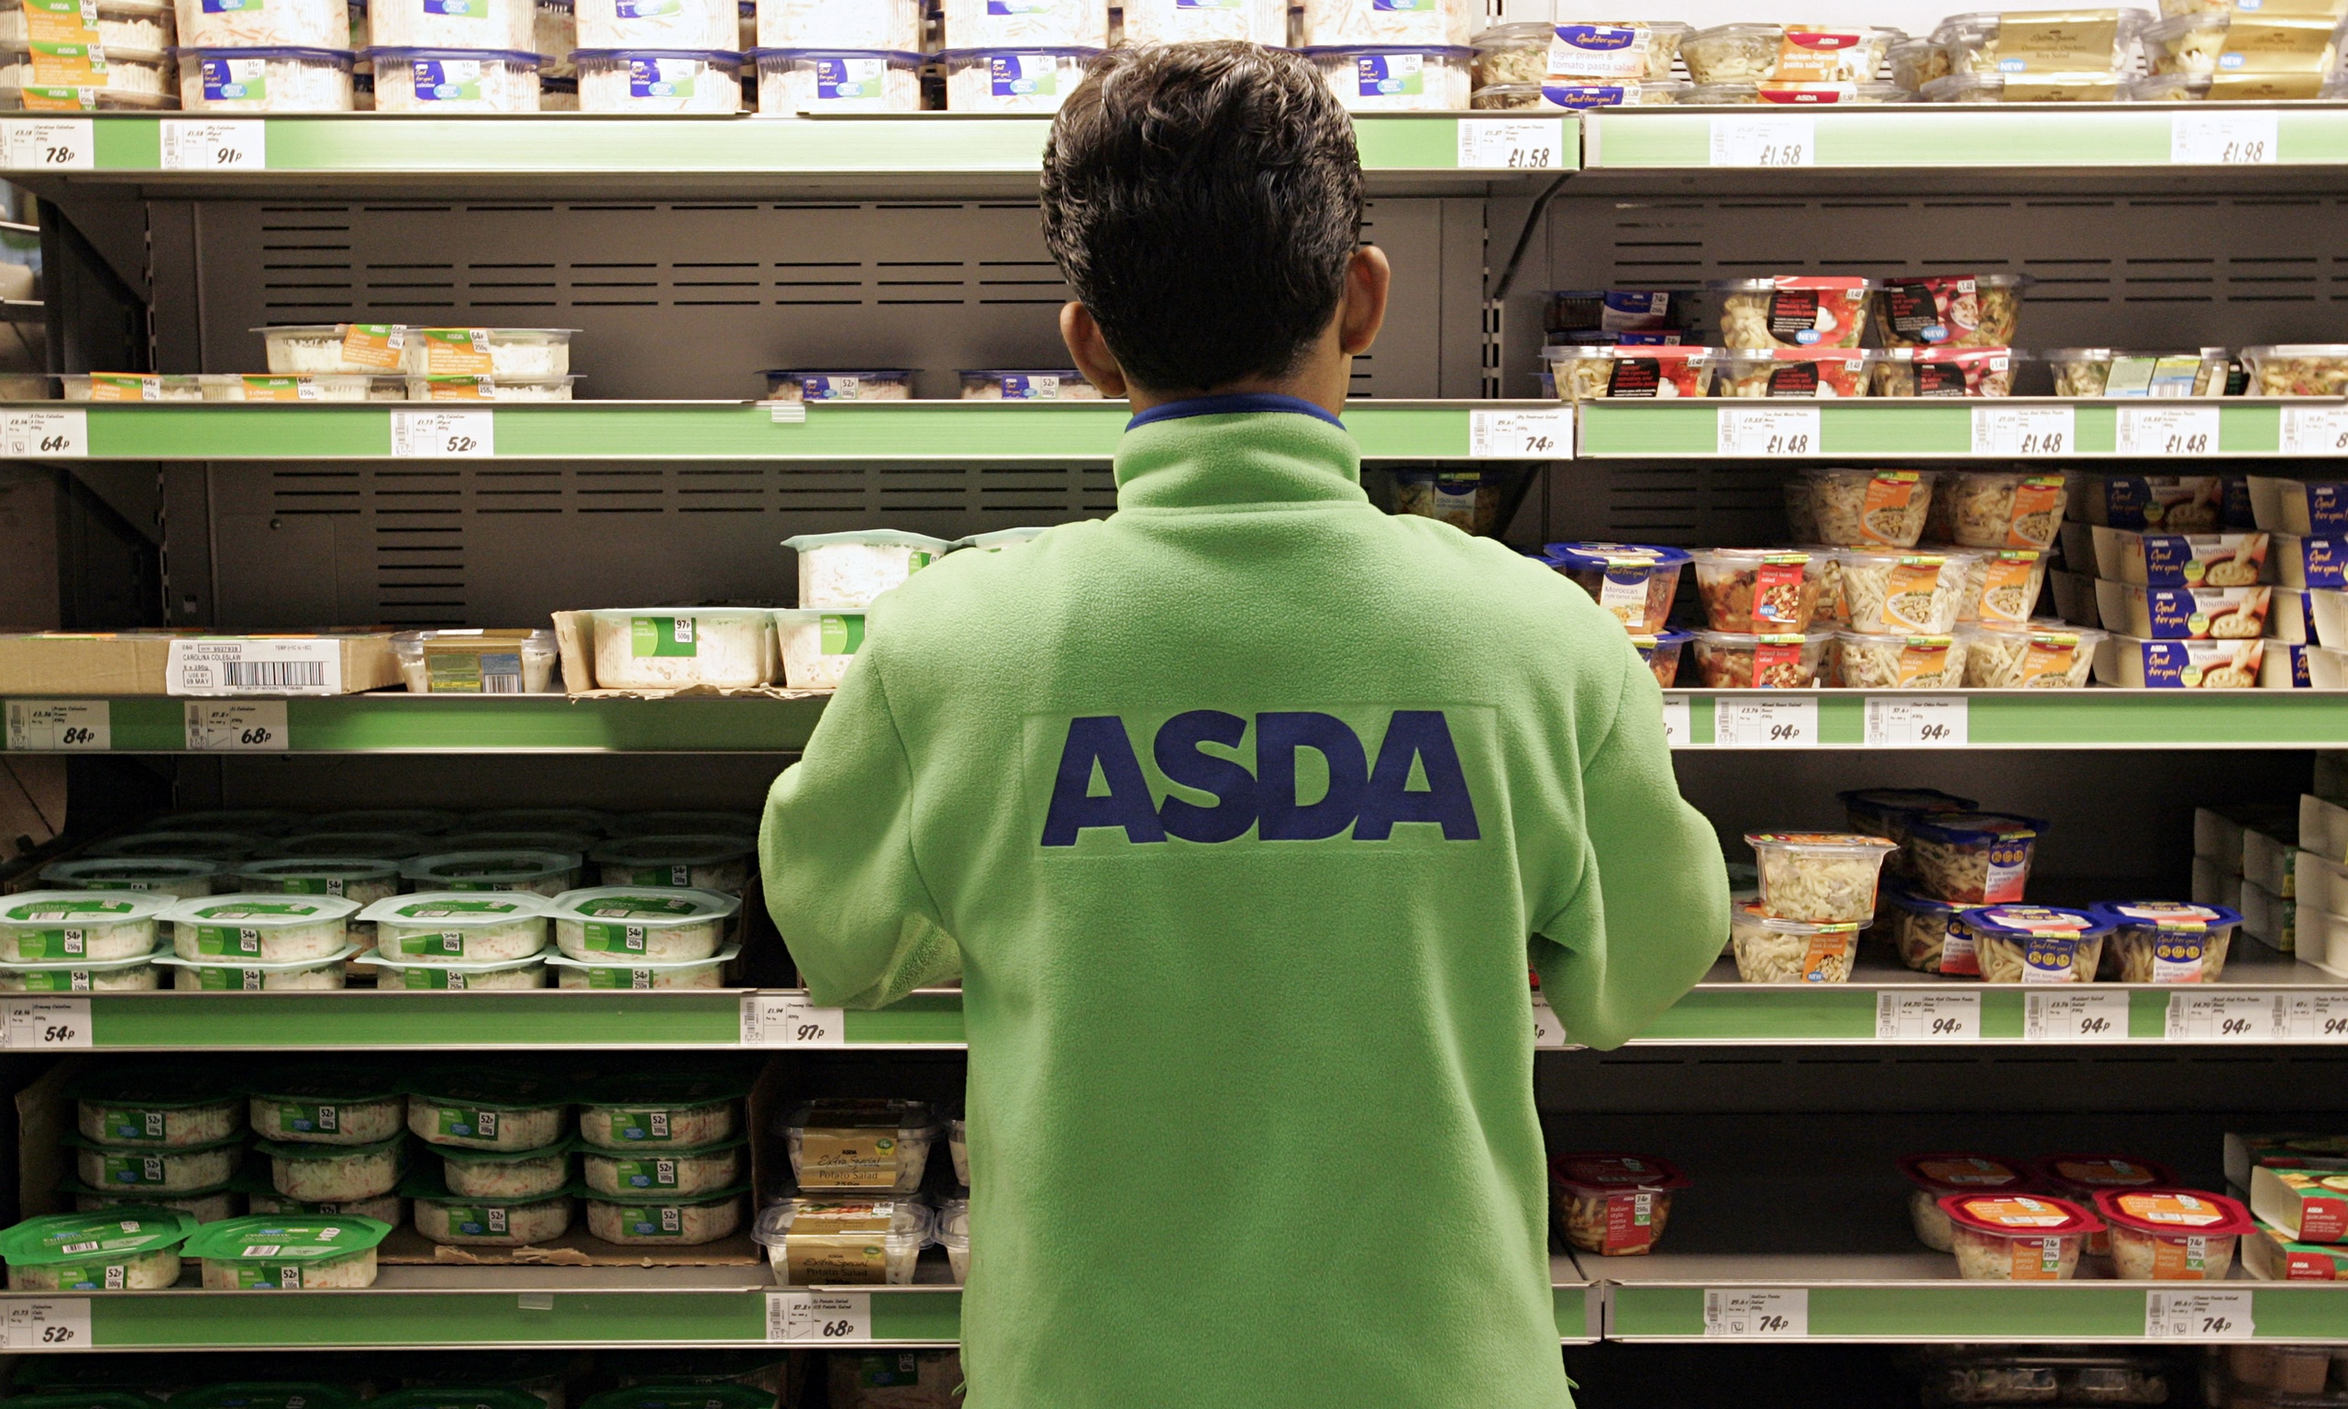
Walmart, the world‘s leading retailer transitioned to SAP Cloud to provide their employees with a state-of-the-art helpdesk.
Walmart’s ASDA division went live in 12 weeks leveraging SAP Cloud for Service to support approx. 190,000 employees through a cloud helpdesk that integrates with SuccessFactors Employee Central, SAP’s cloud HCM suite.

Slide 93
CEOs rank “digital engagement with customers” as most important aspect of digital transformation
McKinsey & Company

Slide 94
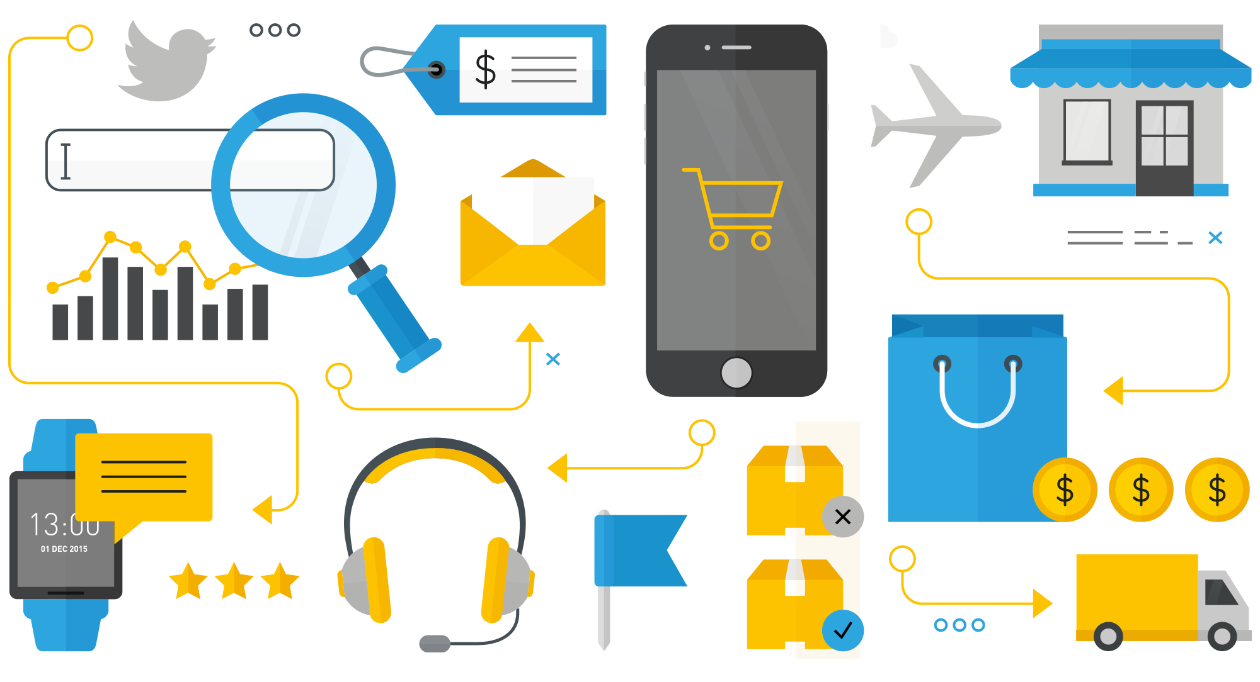

Slide 95
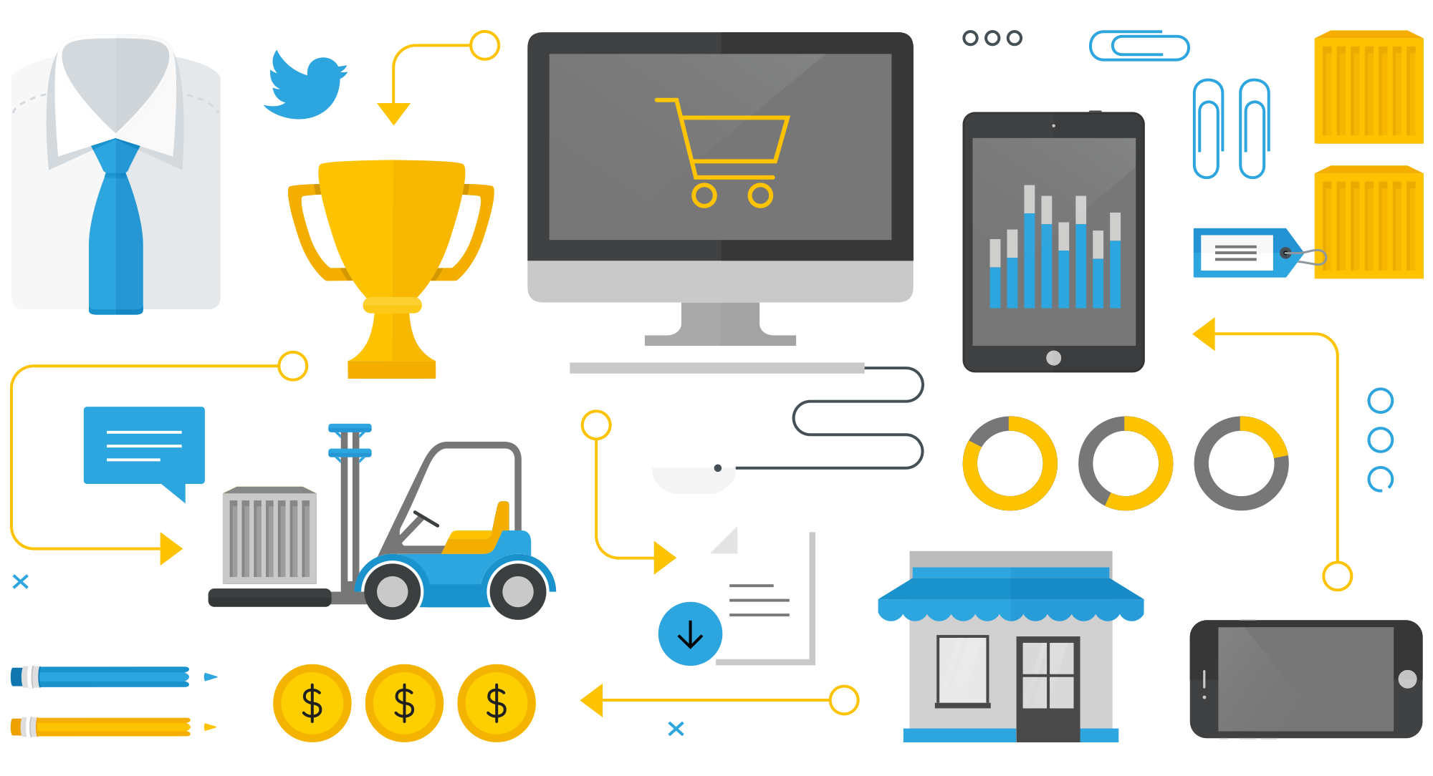

Slide 96
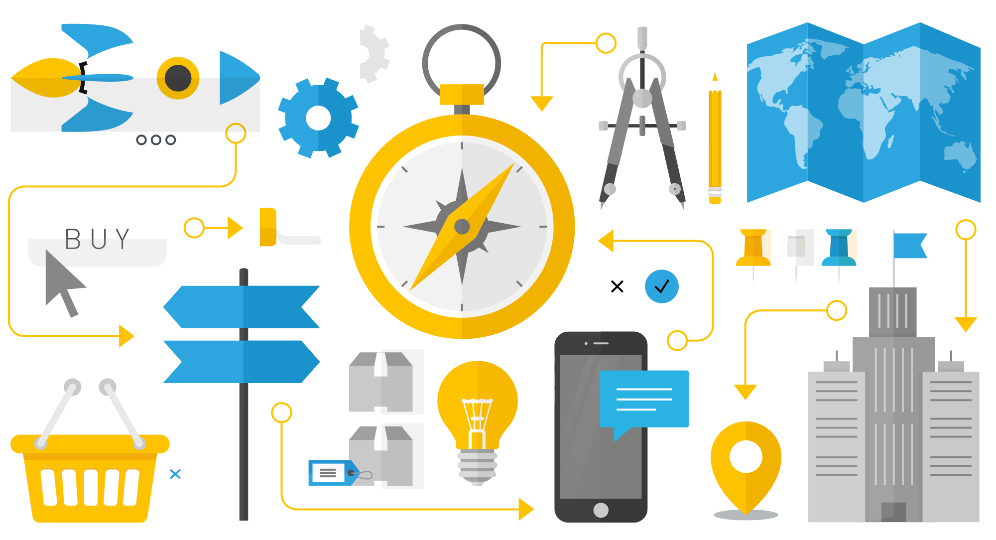

Slide 97


Slide 98


Slide 99

54%
28%
Of those marketers surveyed agree that their customers are demanding more digital experiences, especially via social and mobile channels
Of marketers recognize that delivering personalized experiences to customers have repaid companies not
just in revenue, but also in advocacy

Slide 100


Slide 101


Slide 102

REMEMBER, SOFTWARE EXISTS TO HELP YOU, NOT SLOW YOU DOWN

Slide 103

TO SUCCEED TODAY CONSUMER PRODUCTS BRANDS NEED TO MOVE FROM CARTS TO HEARTS

Slide 104



You need to understand the customer
Product, Category and Brand Affinities
Channel Affinities
Propensities
Segment Membership

Slide 105
99.76%
of online ads are ignored
Source: Google

Slide 106
ENABLE GREAT EXPERIENCES.
SIMPLIFY THE FRONT OFFICE.
TRANSFORM AND BE AGILE.

Slide 107
$250B
BILLED ANNUALLY BY SAP HYBRIS BILLING. NOW EVEN EASIER.

Slide 108


Slide 109

SALES & MARKETING AUTOMATION HAS ENABLED US TO SHOUT LOUDER, AND AT MORE PEOPLE

Slide 110

ARE THEY LISTENING?

Slide 111
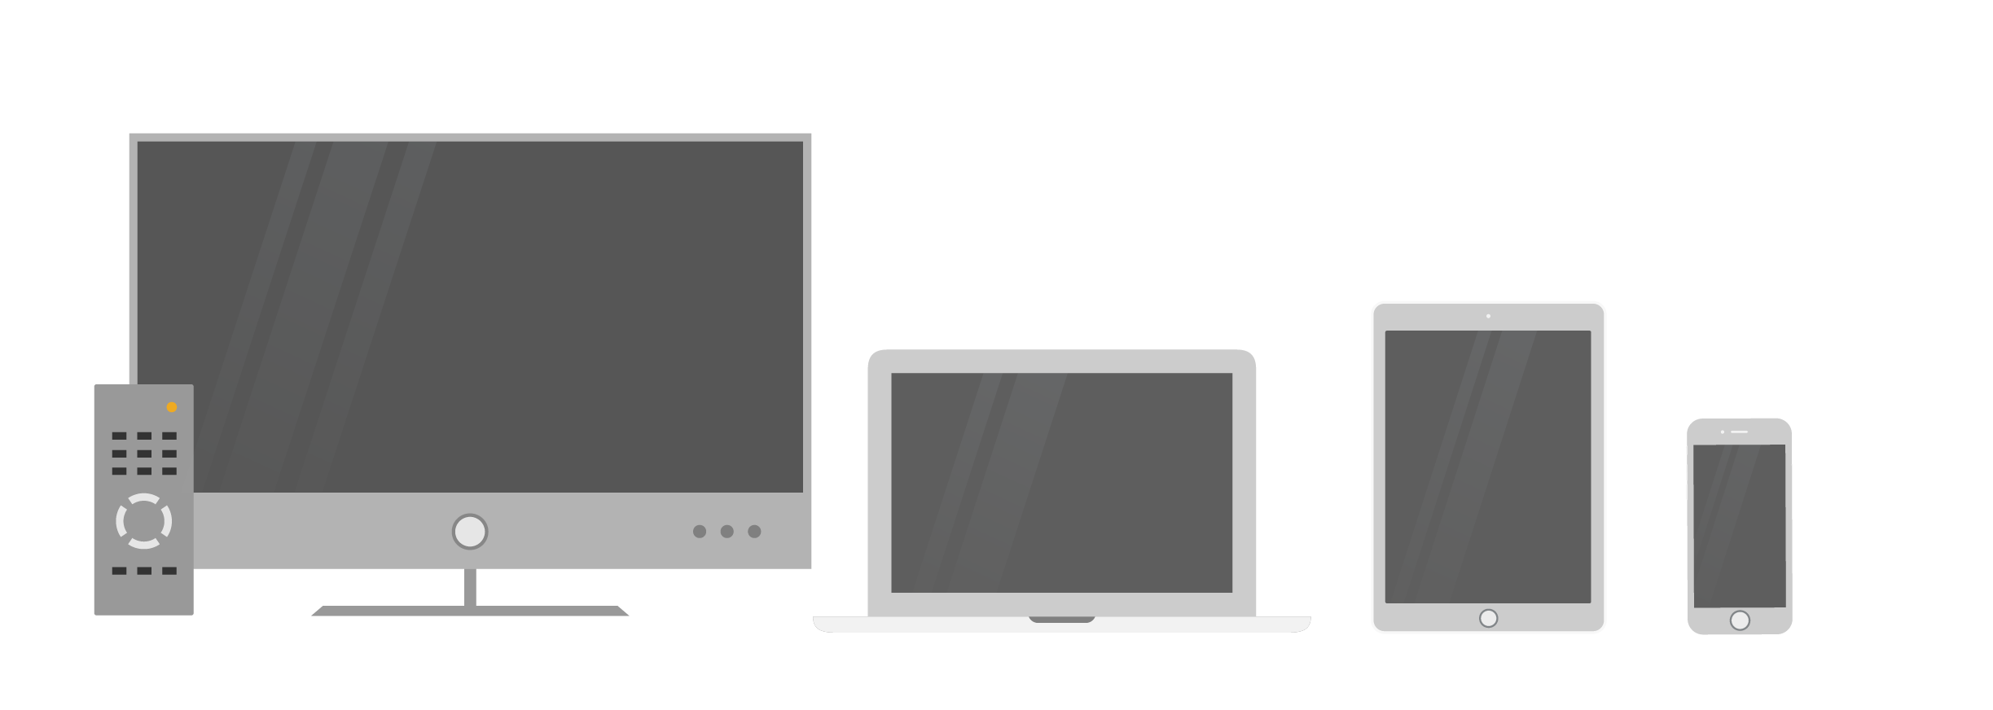
TV
147
TABLET
43
PC
103
PHONE
151
Minutes per day
Source: Milward Brown AdReaction, 2014.

Slide 112
Still looking for custom illustrations / a thorough clean up / that special wow effect? Feel free to send your presentations to:
marketing@snk-interactive.de

Slide 113
THANK YOU

